Slide 1
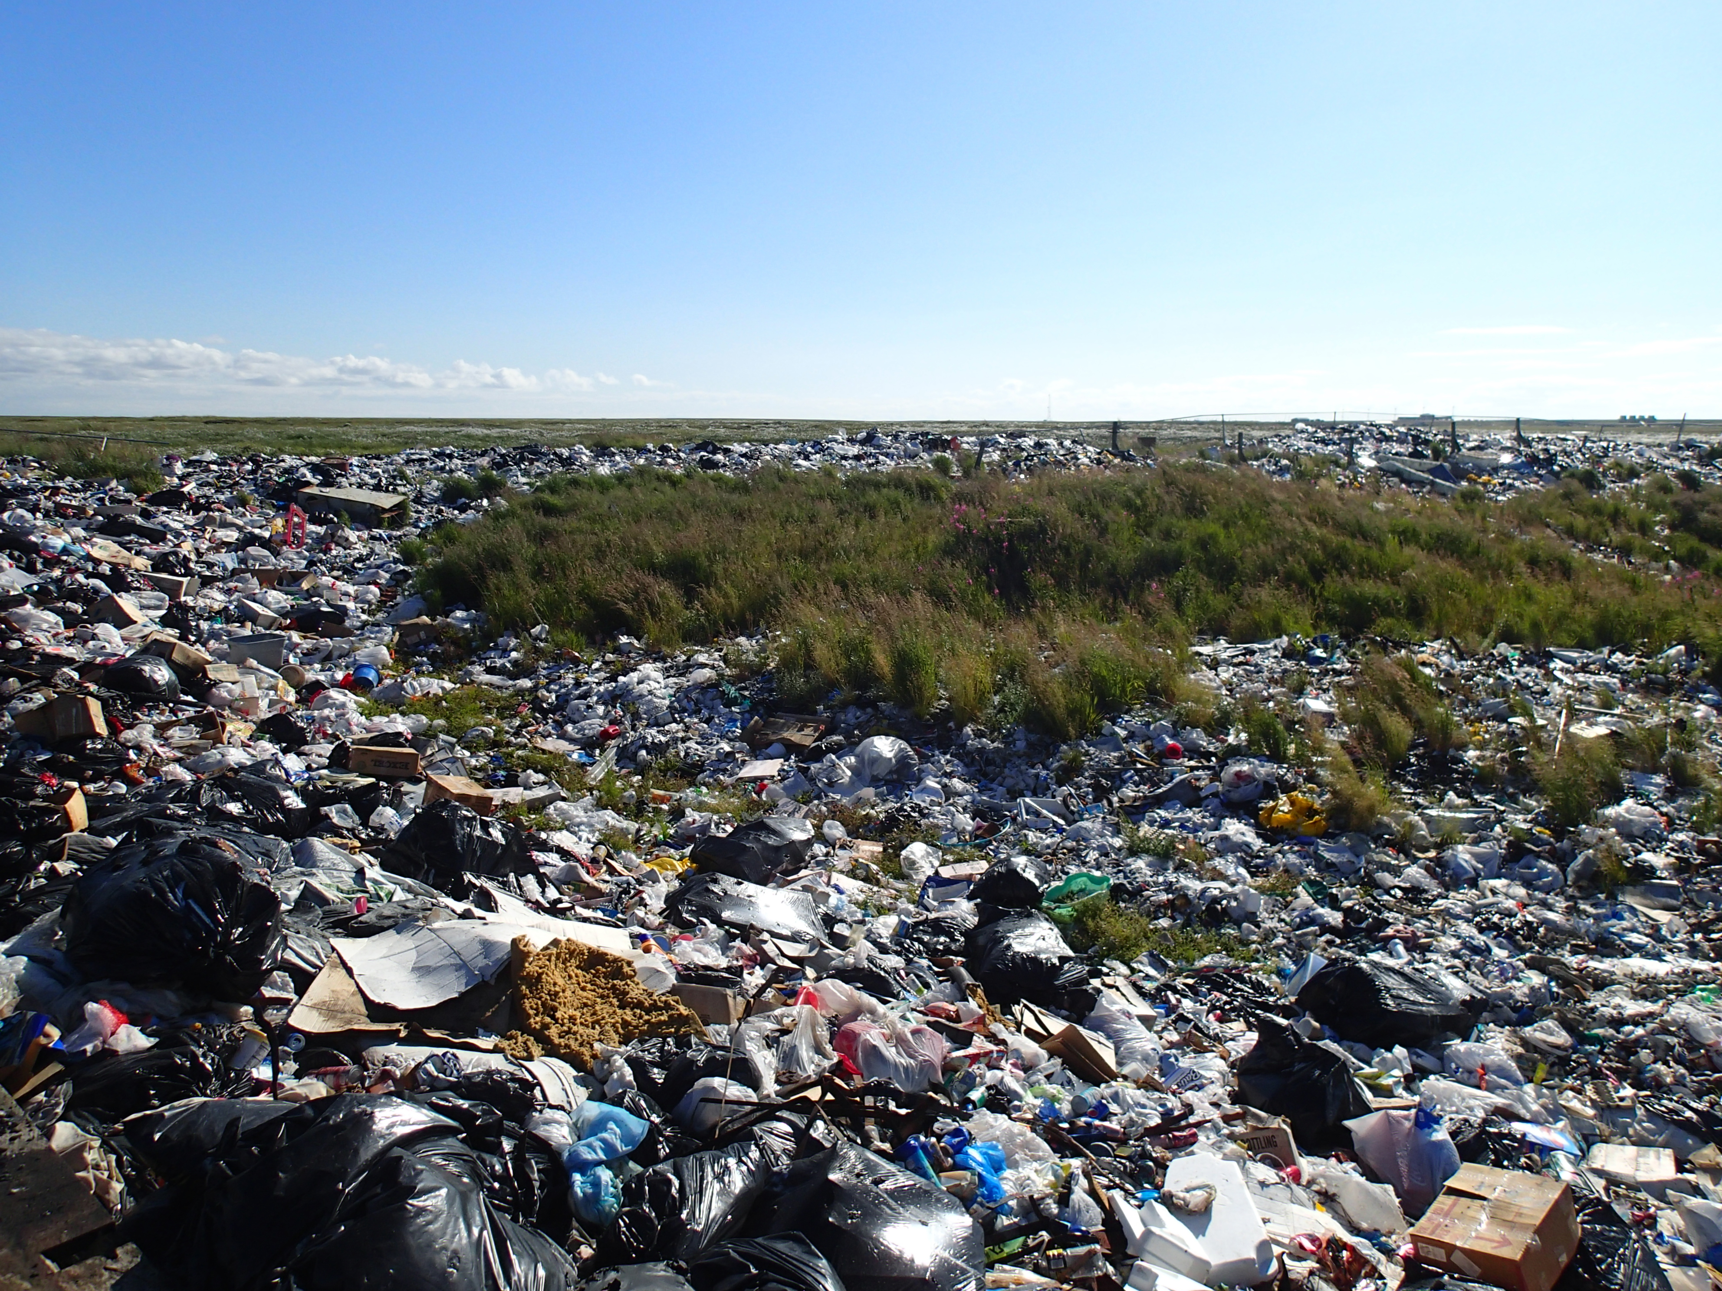
ADEC Solid Waste Program
Notes:
Introductions
What we throw into our landfills has dramatically changed in the last 100 years. The introduction of plastics, chemicals, electronics into the waste stream has created a need to move towards updated disposal methods in order to properly handle new types of garbage. Throughout this presentation we will talk about why the new disposal methods are important in to protect yourself, your community, your food sources, and the environment.

Slide 2
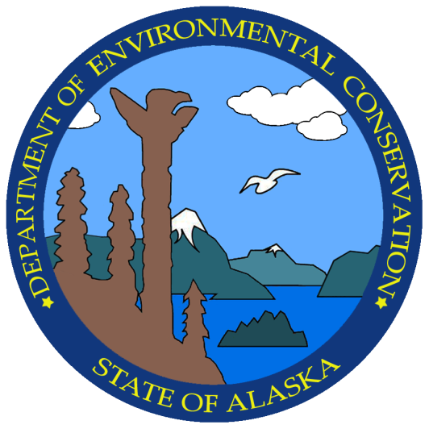
Who are we? What do we do?
Alaska Department of Environmental Conservation
Solid Waste Program
Regulate disposal of solid waste in Alaska
Increase compliance and permitting of our regulated facilities
Inspect large municipal landfills (every year)
Inspect rural landfills (every three years)
Review landfill designs
Provide outreach, education and training
Recommend improvements / Technical assistance
Promote recycling and reuse

Slide 3
Types of Regulated Facilities / Activities
Municipal Solid Waste Landfills
  Class I, Class II, Class III
Monofills
  C&D, sewage solids, asbestos, inert waste, mining waste, drilling waste, wood waste, industrial waste.
Treatment Facilities
  Drilling waste, medical waste, biosolids and other wastes
Land Application of Biosolids

Slide 4
Class I Landfills
Anchorage, Fairbanks, Ft. Wainwright, Juneau, Kodiak, Oxbow, Palmer, Soldotna, Unalaska
Accept more than 20 tons of waste per day
  Anchorage takes 1,000 tons per day
Municipal Solid Waste (MSW) cells are lined
Waste covered with 6 inches of soil everyday
Leachate (waste + water) collection
Surface or groundwater monitoring (usually 2x year)
Air monitoring (rotting waste produces methane)
Manager of Landfill Operations (MOLO) certified Landfill Manager or Operator

Slide 5
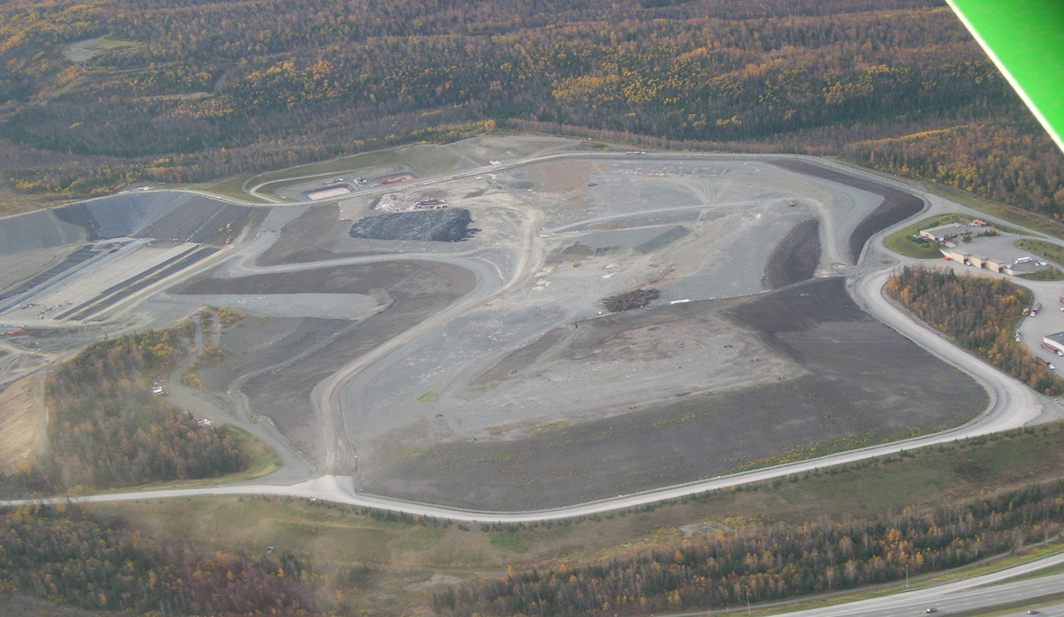
Anchorage Regional Landfill

Slide 6
Class II Landfills
Barrow, Bethel, Cordova, Delta Junction, Denali, Dillingham, Eareckson Air Station, Fort Greely, Glennallen, Kotzebue, Naknek, Nome, Valdez
Accept between 5 and 20 tons of waste per day
Surface or groundwater monitoring (usually 2x year)
Waste covered with soil everyday
Air monitoring (rotting waste produces methane)
MSW Cells are not lined
No leachate collection
Landfill Managers / Operators must have at least Rural Alaska Landfill Operator (RALO)

Slide 7
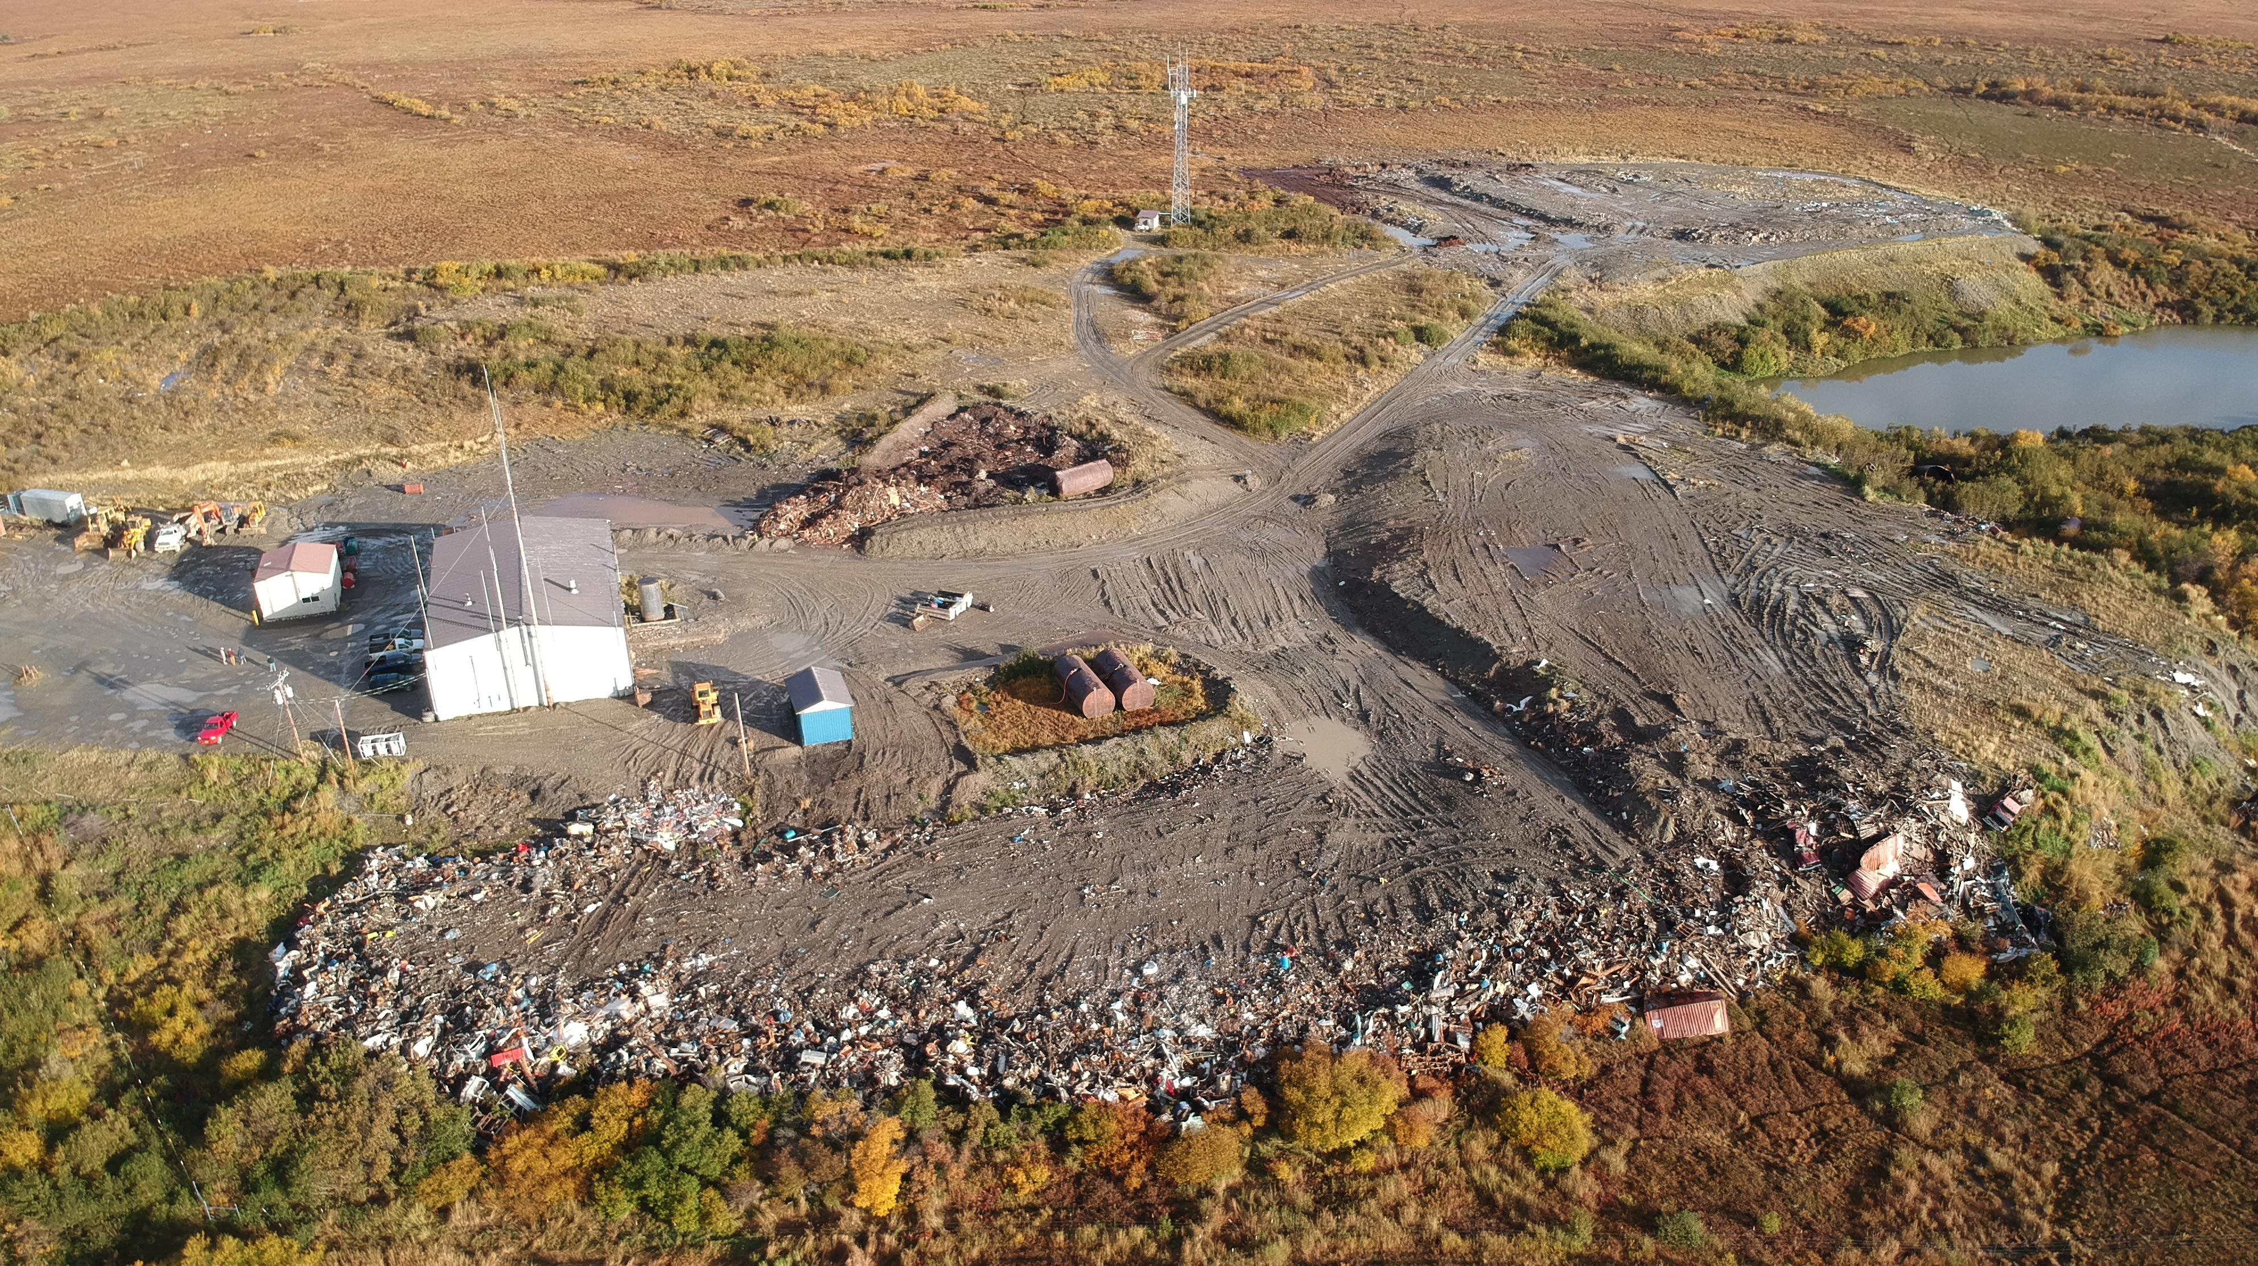
Naknek Landfill

Slide 8
Class III Landfills
-Everywhere else-
Accept less than 5 tons of waste per day
Waste should be covered with 6 inches of soil often enough to control issues (windblown litter etc.)
MSW Cells are not lined
No leachate collection
No water monitoring (unless required)
No air monitoring (unless required)
Landfill Operators should have at least Rural Alaska Landfill Operator (RALO) training

Slide 9
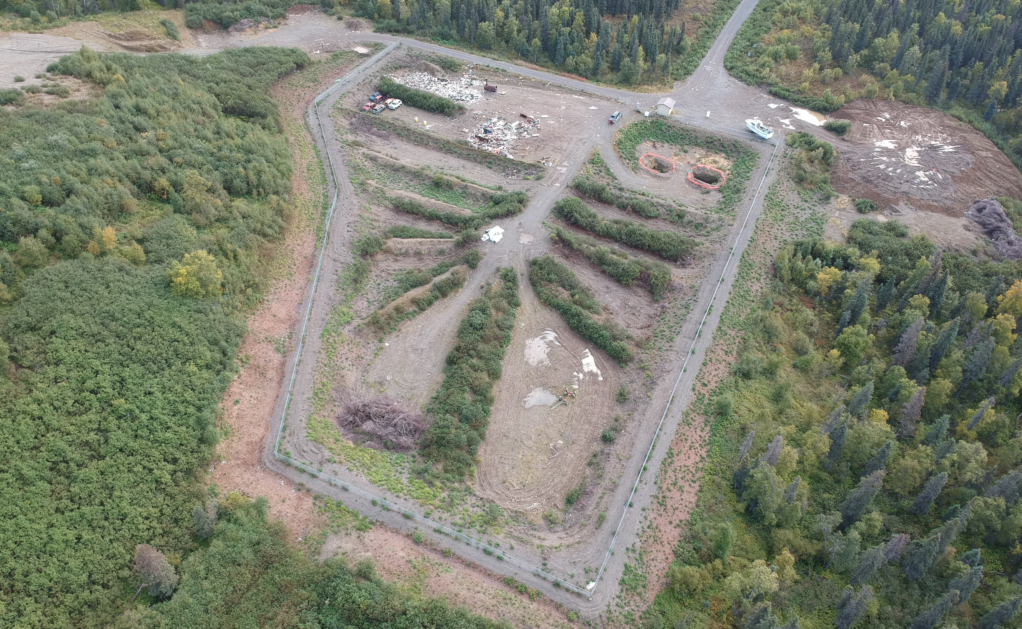
Class III Landfill

Slide 10
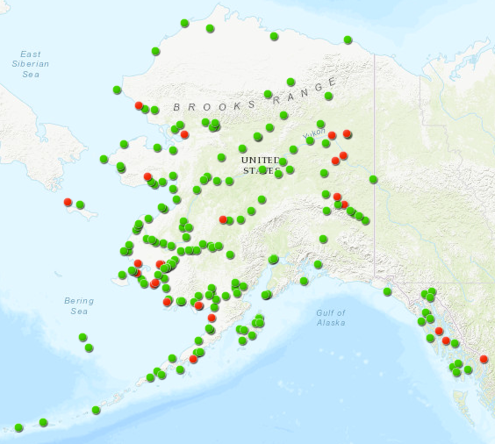
  183 total Class III landfills
Permitted Class III - 158
Unpermitted Class III - 25
Notes:
These are where all the rural landfills in Alaska are and we regulate all 183 of them.

Slide 11
Disposal of Construction and Demolition Debris
C&D debris must be disposed in a permitted landfill.
C&D debris does not include: food or other putrescible waste, polluted soil, liquids, hazardous waste, PCBs, or regulated asbestos.
Most landfills in Alaska are permitted to accept C&D debris however they are not obligated to accept it.
If the local landfill will not accept the waste, there are other options including an developing an inert waste monofill (large project), a one-time C&D or asbestos monofill (small project) or shipping the waste out.

Slide 12
Planning Makes All The Difference
Identify all potentially hazardous materials and have them tested, and properly disposed
Know your disposal options
Consider waste reduction and reuse options
Contact ADEC to ensure proper landfill permits
Work with the Community for mutual benefit

Slide 13
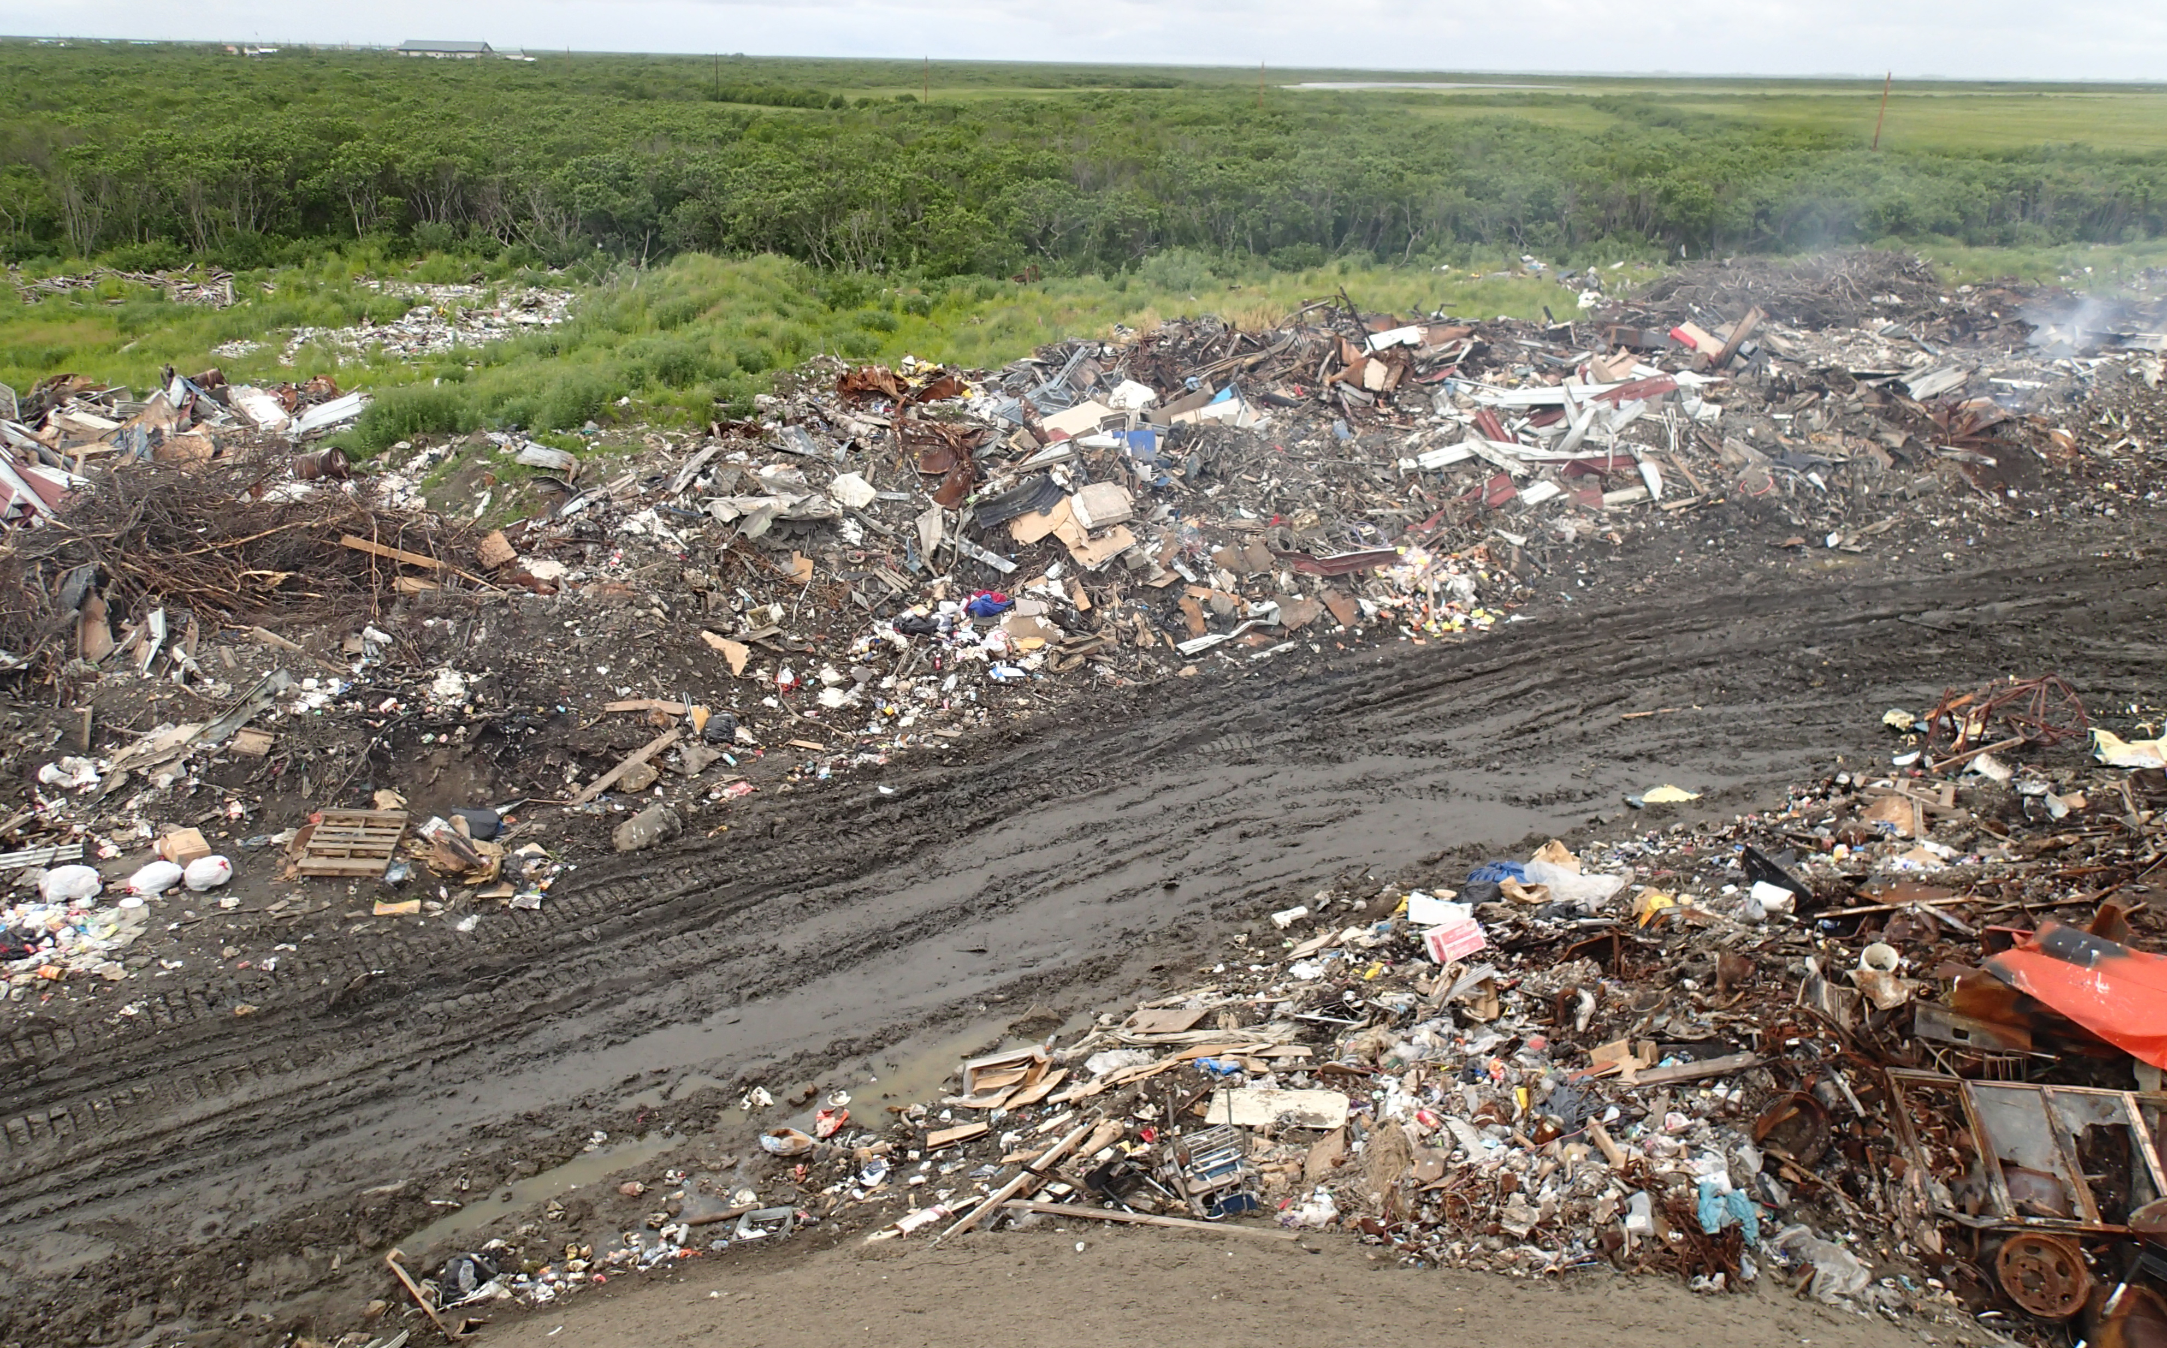

Slide 14
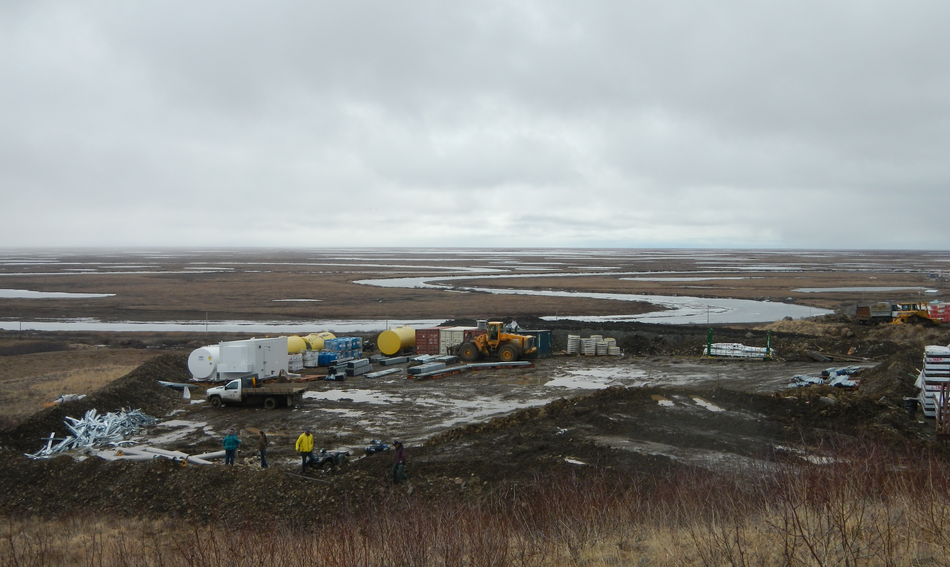

Slide 15
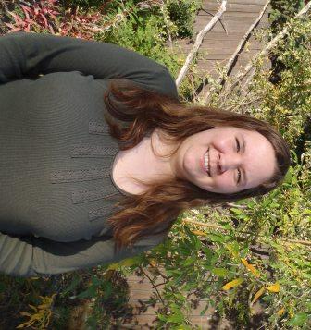
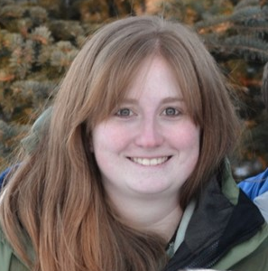
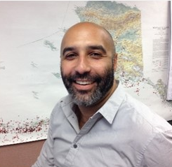
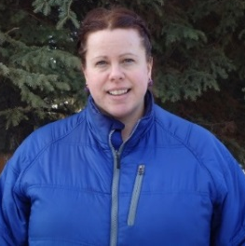
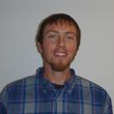
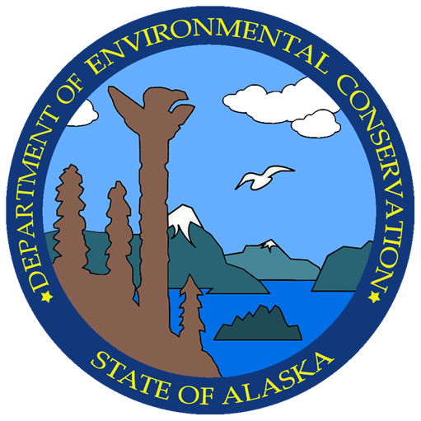
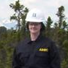
Rural
Landfills
ADEC
Solid Waste Program Contacts
Other
Landfills
Program Manager
Bob Blankenburg
907-269-7690
Trisha Bower
Northern & Interior
451-2174
Statewide
Kaylie Holland
Large Municipal Landfills
Southcentral/Western
269-7626
Southcentral/Western
Regional Manager
Lori Aldrich
269-7622
Stephen Price
Bristol Bay, Lake & Penn
Kodiak, Lower Yukon
269-7467
Northern/Interior/Southeast
Regional Manager
Doug Buteyn
451-2135
Sarah Durand
Interior/Upper Yukon
451-2761
Neil Lehner
Municipal/Industrial Landfills
Northern/Interior
451-2134
General Program Info
Rebecca Colvin
269-7802
Water Monitoring &
Technical Assistance
Young Ha
269-1099
Hannah Sullivan
Southeast/NW Arctic
465-5318
Melinna Faw
Kuskokwim/Aleutians East
269-7642
Reese Thieme
Oil and Gas Facilities
Statewide
269-7590

